Slide 1

ConverStation

Slide 2
Concept Video Link:
https://youtu.be/3lTLfvislgY

Slide 3
ConverStation:
Meet new people, find new perspectives
Everyday we are surrounded by so many people with a variety of background, interests, and life stories. We could learn so much from talking to these people, but we often times find it awkward to just approach a stranger and start a conversation, especially if we’re not sure if they’re busy or available. Our solution is ConverStation, which connects users who are both available in the same immediate area, prompting them to start a conversation and meet someone they would have otherwise passed right by.

Slide 4
TASKS

Slide 5
Meetup! (Simple)
Jack has some free time at the park but doesn’t have anyone to hang out with or anything to do, so he decides to turn on ConverStation. After a few minutes, he gets a notification that another ConverStation user, Jill, is in the same area. ConverStation gives them each other’s photo so they can recognize each other, names and pronouns to get that out of the way, a potential topic to start the conversation with, and a closeby public place for them to meet. Jack and Jill introduce themselves and have a nice 15 minute conversation. Jack learns about Jill’s interest in Japanese History and Jill learns about Jack’s struggles finding a CS internship. Each gains a new perspective through their conversation as well as a new friend. The two exchange phone numbers so that they can keep in touch before parting ways.

Slide 6
Search for a meetup in the future (Medium)
Mike has a pocket of free time between classes tomorrow from 3:00pm to 3:30pm. He doesn’t have any plans, so he decides to ask ConverStation to find him a conversation partner during that time. ConverStation matches Mike with Ike, who is visiting from abroad and will be in the same area at that time. Come tomorrow, ConverStation shows Mike and Ike where to meet, and Mike learns all about life in Ike’s home country of Yugoslavia. Though their conversation was short, Mike was introduced to a new culture and made a friend on the other side of the world.

Slide 7
Host an event (Complex)
Right now, Don and Gilda are hosting a flash fiction reading and discussion at the cafe, but nobody showed up! They decide to post their event on ConverStation. ConverStation notifies nearby active users Norman, Emma, and Ray of the event happening now, and they decide to join in. Norman, Emma, and Ray bring interesting ideas and perspectives to the reading that Don and Gilda wouldn’t have found on their own, and the five decide to make their Flash Fiction meetings a regular occurence.

Slide 8
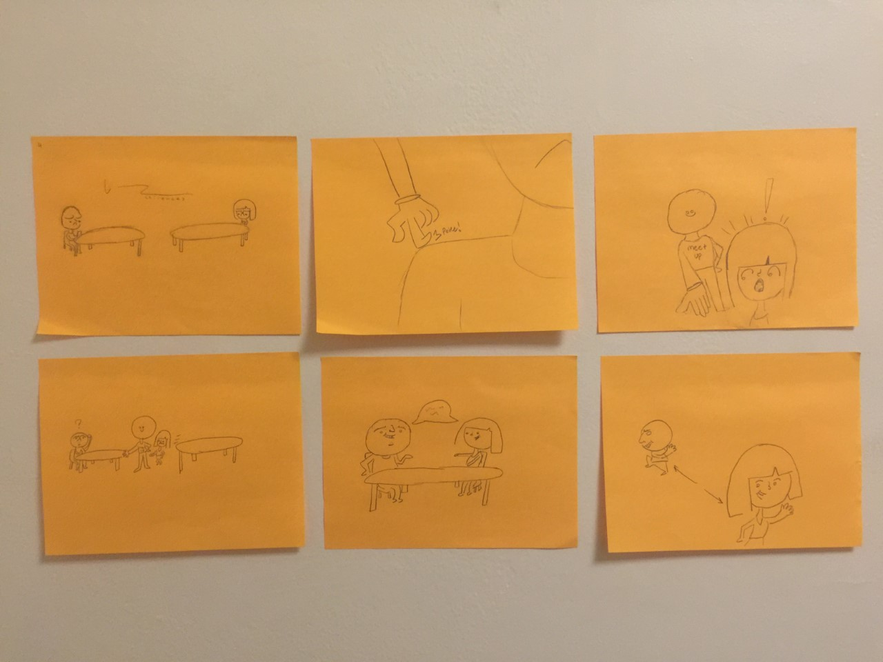
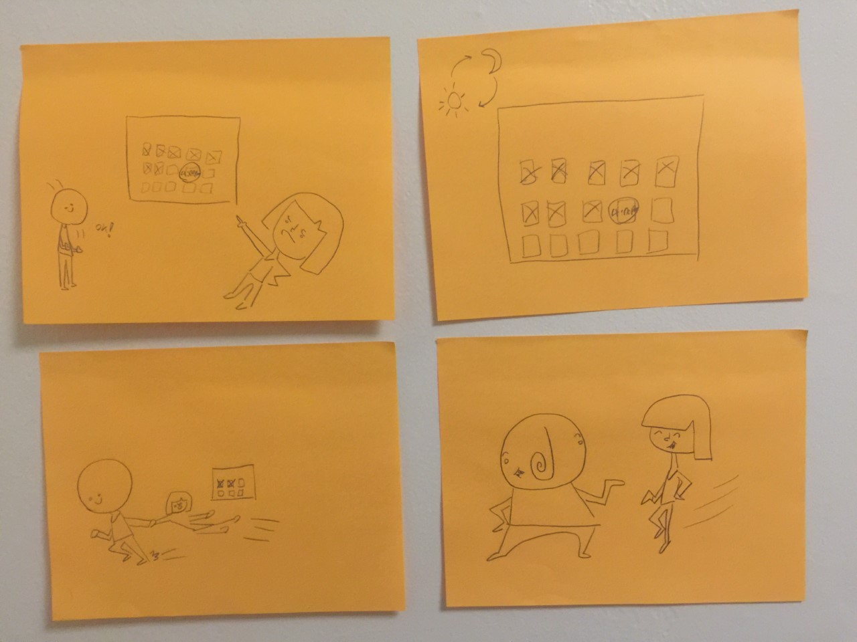
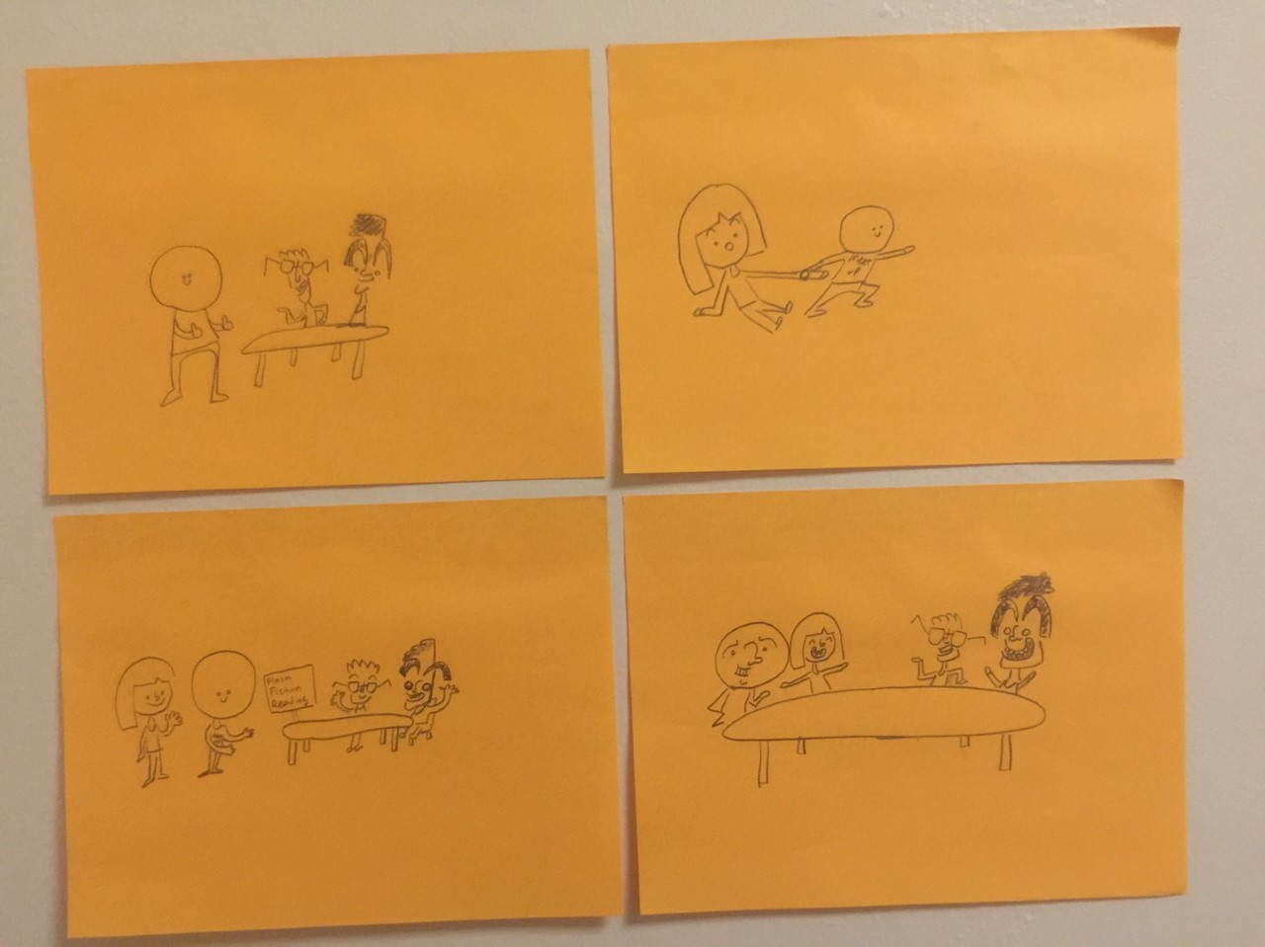
Storyboards

Slide 9
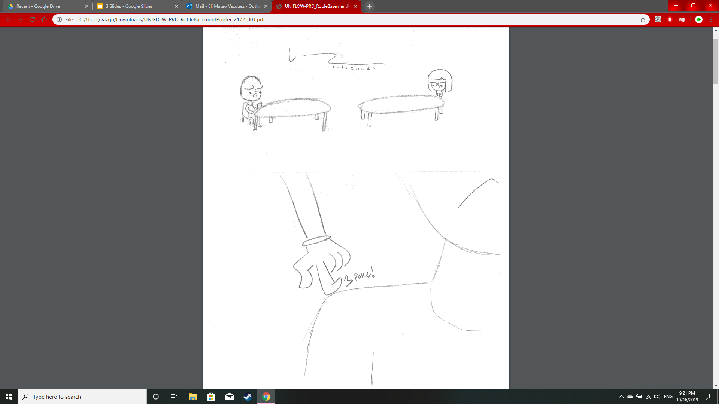
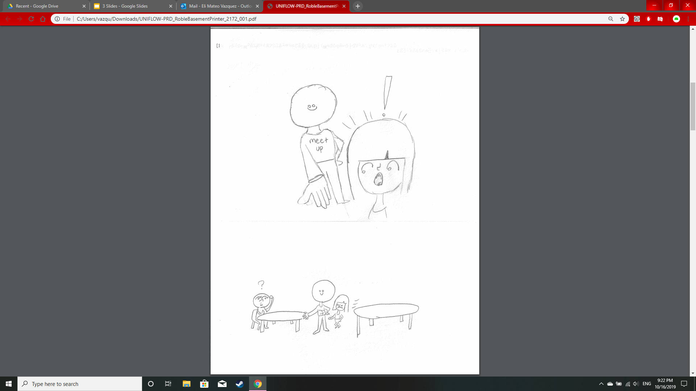
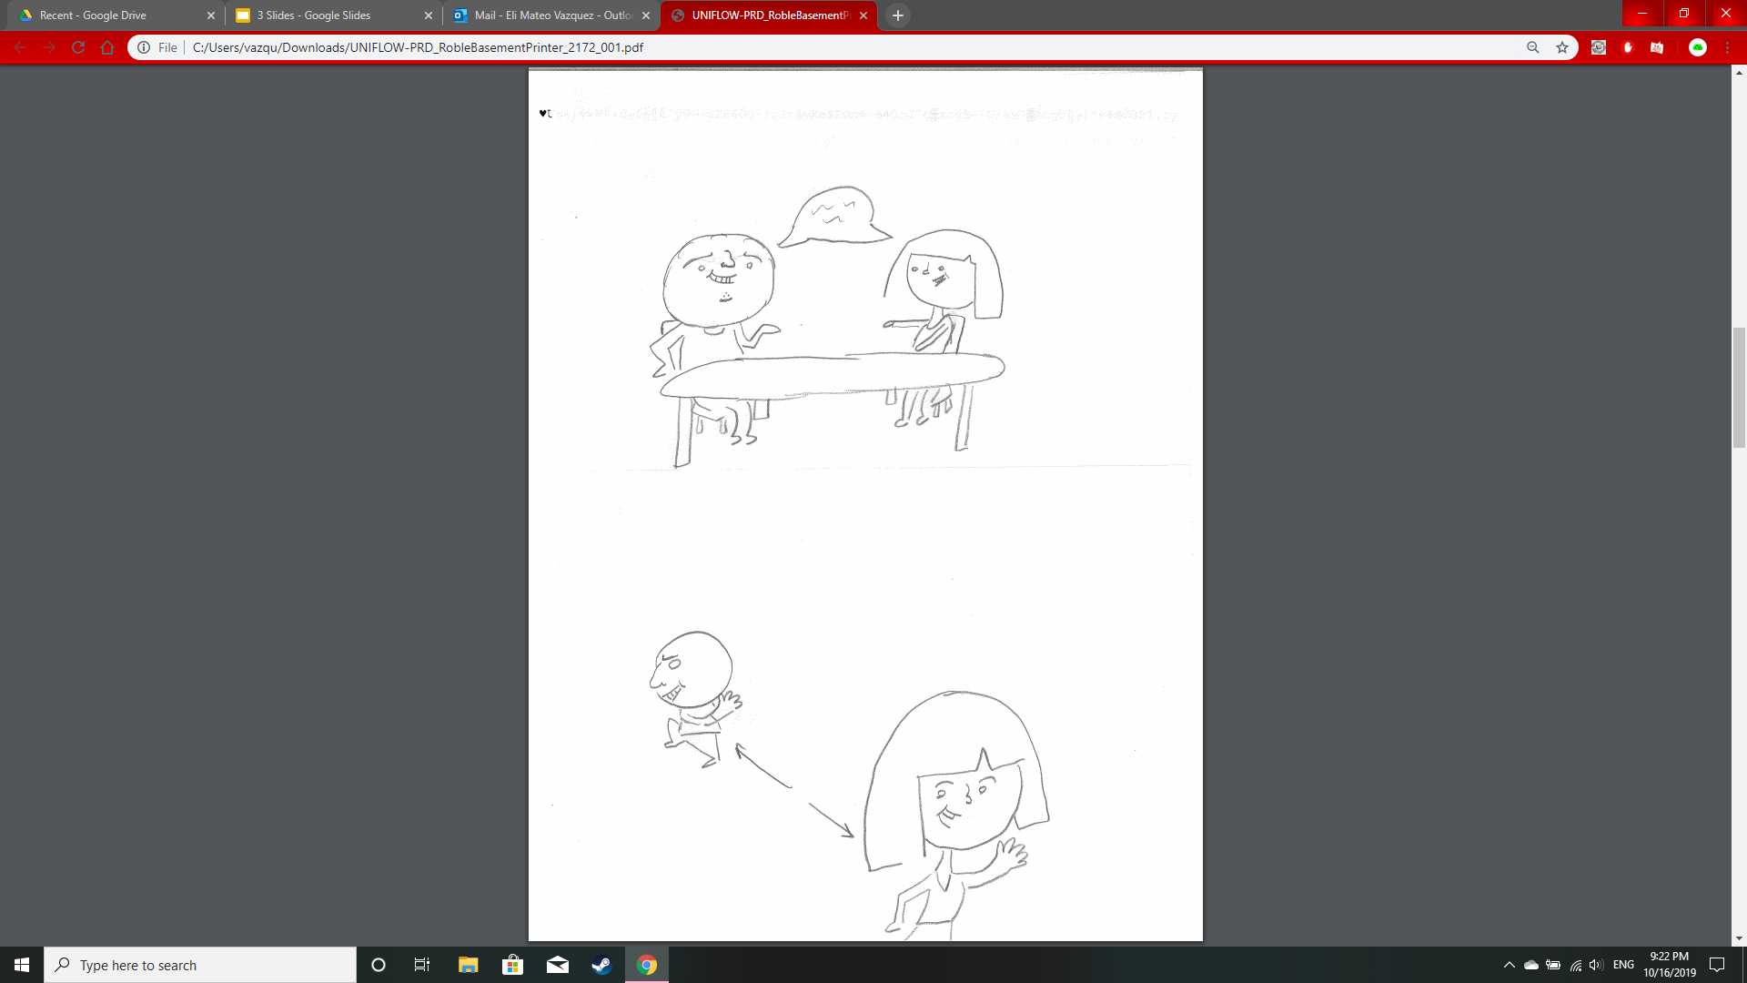
T
A S K 1
(Strangers sit in silence, looking at their phones)
(A poke on the shoulder?)
(It’s Mr. ConverStation!)
(Why don’t you two sit together and talk?)
(What a lovely conversation!)
(Bye bye new friend)

Slide 10
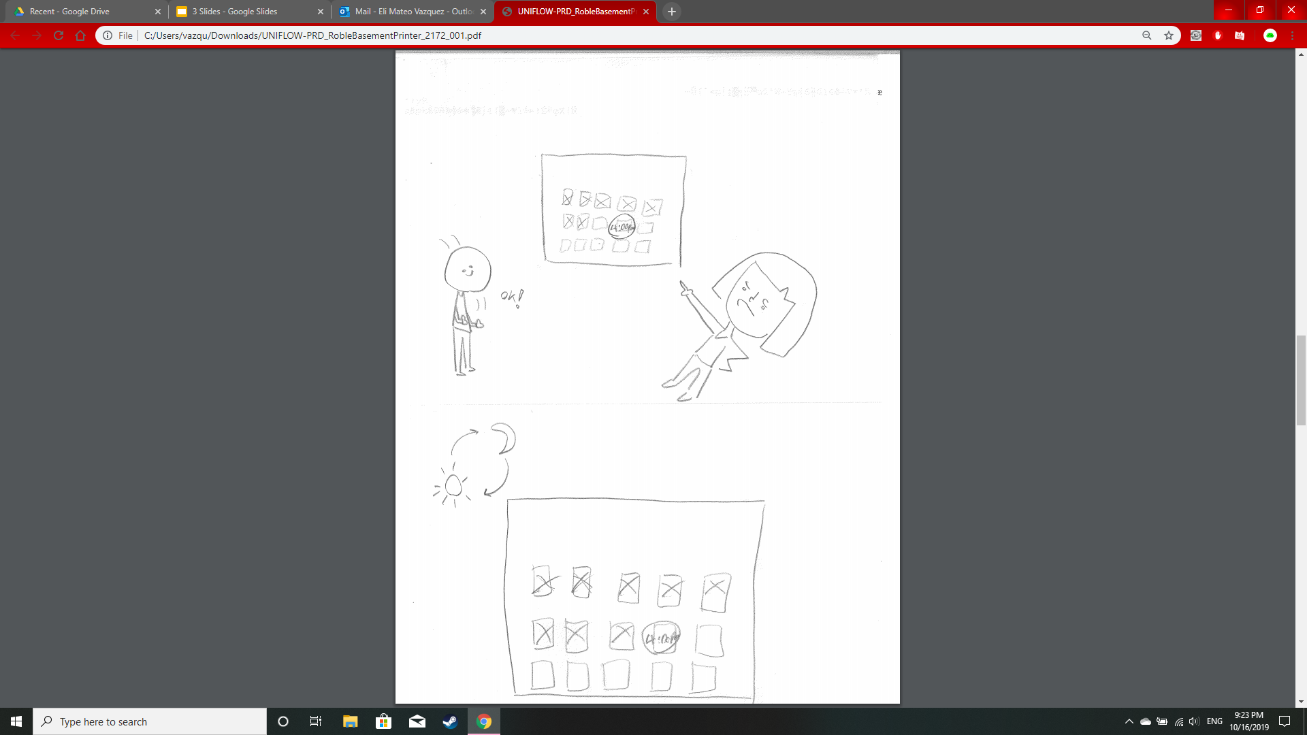
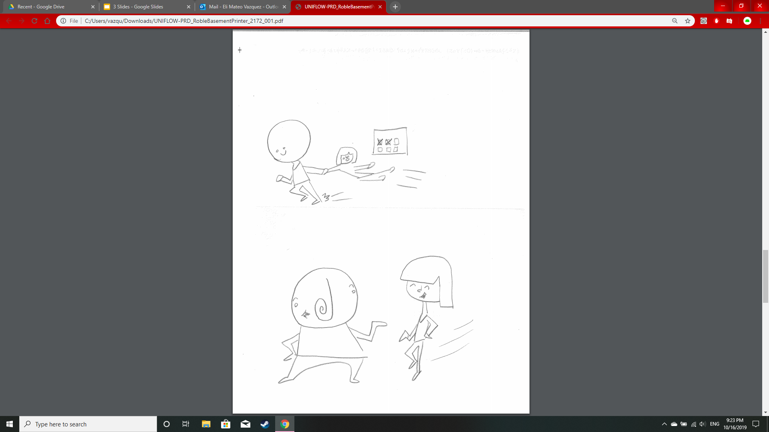
T
A S K 2
(Mr. ConverStation, I want a conversation partner at 4:00pm tomorrow!)
(1 Day Later)
(And awaaaaay we go . . .)
(. . . to a new conversation!)

Slide 11
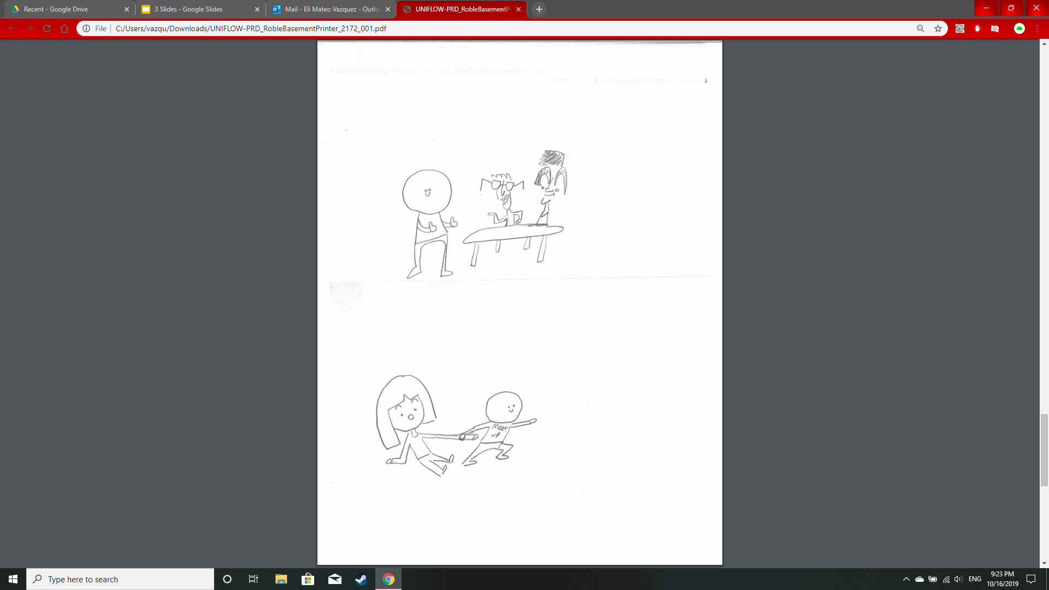
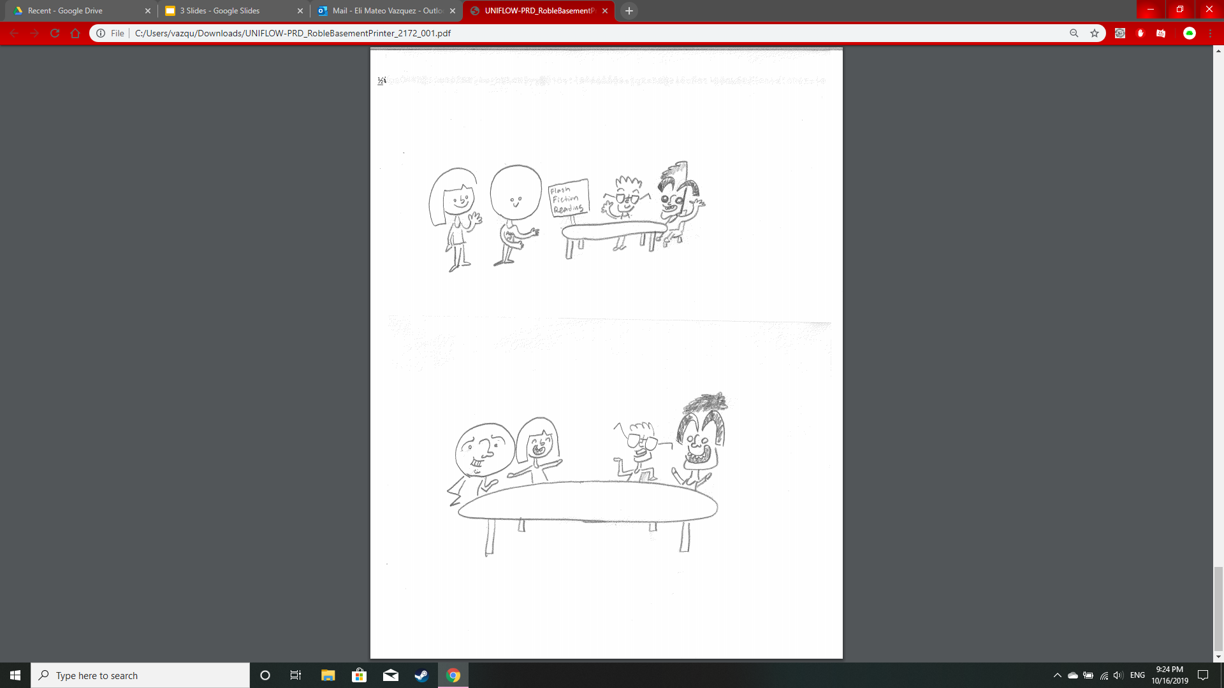
T
A S K 3
(Mr. ConverStation, find more people for my event!)
(This way, ma’am)
(Why not join this lovely event?)
(And a great time was had by all)

